Slide 1
AWS DeepRacer
Object Avoidance
Jason Caldwell

Slide 2
Executive Summary
23 models were trained from 15 minutes to 3 hours
Some were also cloned from earlier versions
4 models passed evaluation
3 laps without going completely off track
Some also avoided 2 fixed objects
Only 29% of project’s budget was used

Slide 3
AWS DeepRacer
System to explore reinforcement learning and to build autonomous driving applications.
Consists of:
AWS DeepRacer Console
AWS DeepRacer Vehicle
AWS DeepRacer League

Slide 4
AWS DeepRacer Console
Graphical user interface.
Train a reinforcement learning model with a specified reward function, optimization algorithm, environment, and hyperparameters.
Choose a simulated track to train and evaluate a model by using SageMaker and AWS RoboMaker.
Clone a trained model to optimize your model's performance.

Slide 5
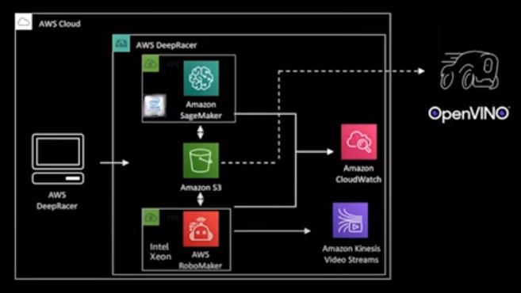
AWS DeepRacer Architecture
SageMaker
S3
RoboMaker
CloudWatch
CloudFormation
Lambda
Tensorflow

Slide 6
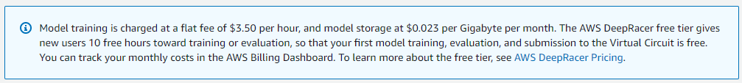
Project’s Budget was $100
Evaluated progress after:
free trial had expired
every $25
Spent $28.64 total
Some examples online would cost $10k+ to replicate
See Next Steps slide for ways to reduce

Slide 7
Setup Models
Tracks
AWS Summit Raceway
provides a solid training warm up.
Oval Track
good choice for getting started.
re:Invent 2018 Wide
use it to get started with object avoidance.

Slide 8
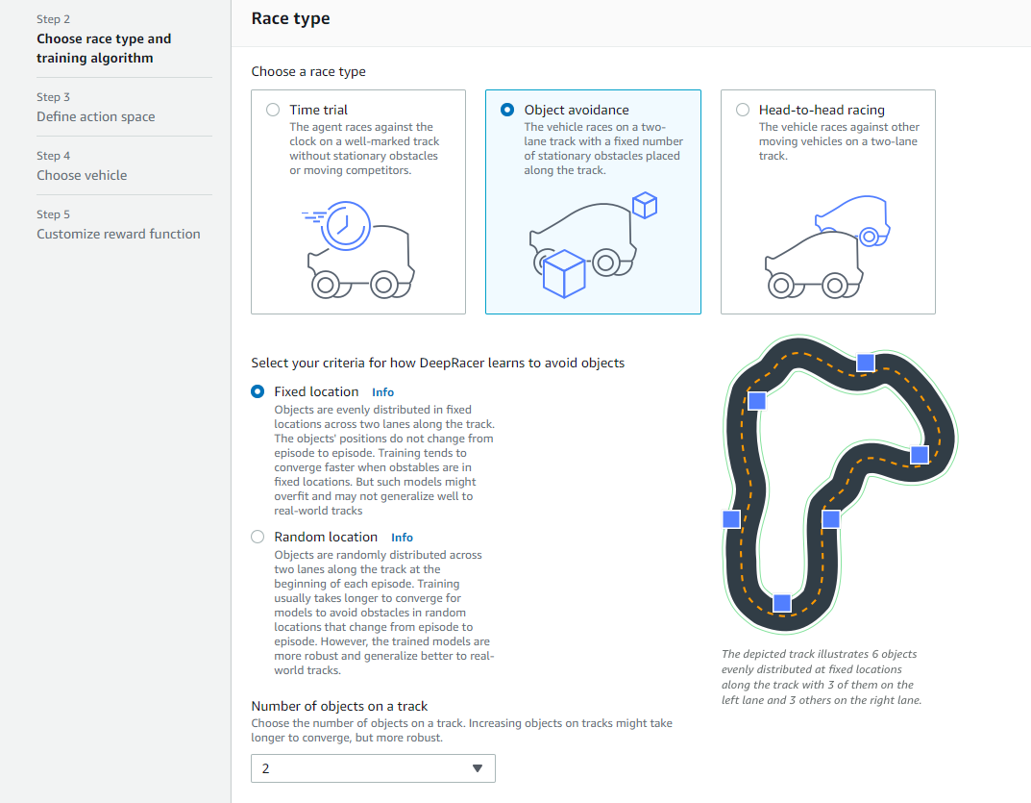
Race Types
Time trial
Object avoidance
1 to 4 fixed objects

Slide 9
Hyperparameters
Used default setup except for discount factor.
Gradient descent batch size: 64
Entropy: 0.01
Loss type: Huber
takes smaller increments than mean squared error
Number of epochs: 10
Discount factor: 0.5
Learning rate: 0.0003
Number of experience episodes between each policy-updating iteration: 20

Slide 10
Vehicle Sensors
Images are converted into grayscale.
Camera
lowest cost sensor solution
Stereo camera
can generate depth information of objects on track
LIDAR sensor
light detection and ranging sensor
continuous visibility

Slide 11
Reward Functions
Used to incentivize car (agent) to take specific actions as it explores the track (environment).
Lambda functions written in Python
Used several to train the different models
The best performing model combined multiple examples

Slide 12
Input Parameters
all_wheels_on_track
closest_objects
distance_from_center
heading
is_left_of_center
is_reversed
objects_location
objects_left_of_center
progress
steering_angle
track_width
waypoints
x
y

Slide 13
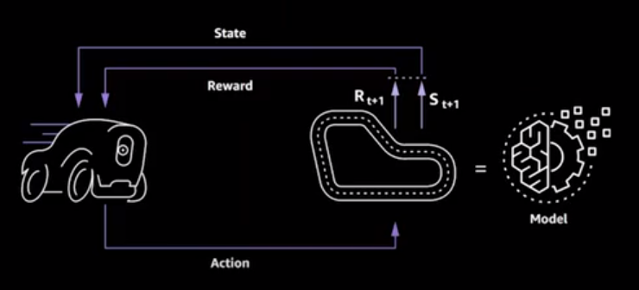
Reinforcement Learning Process

Slide 14
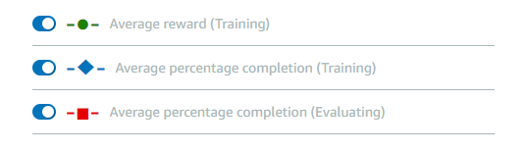
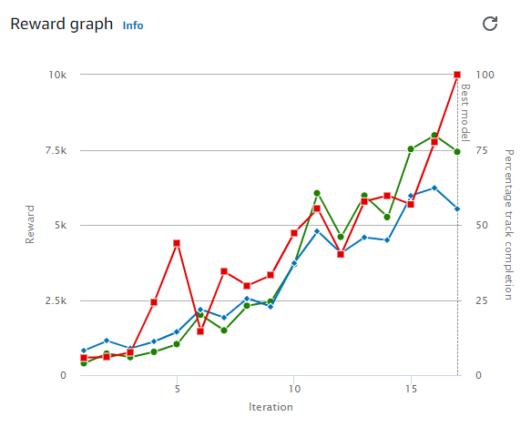
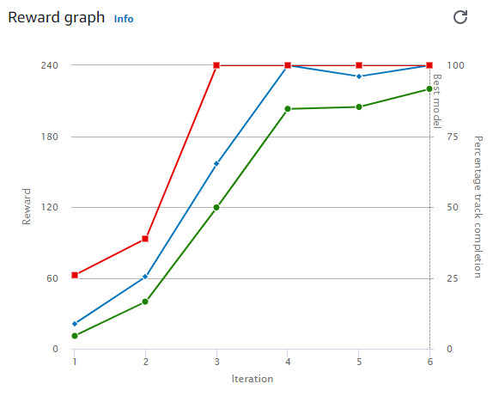
Positive Training

Slide 15
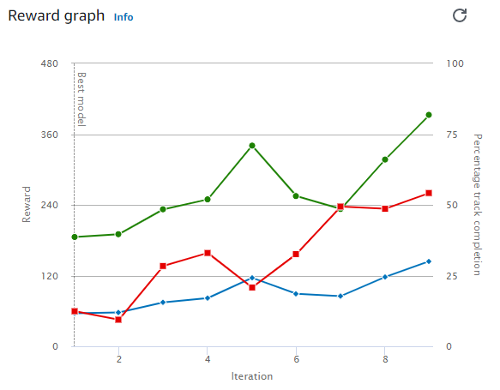
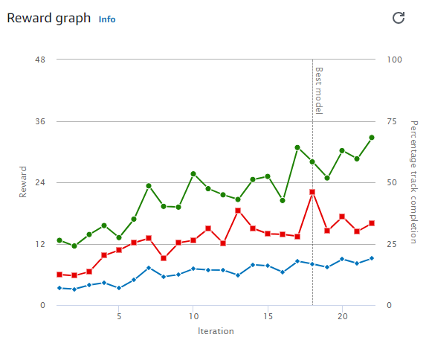
Slower Training

Slide 16
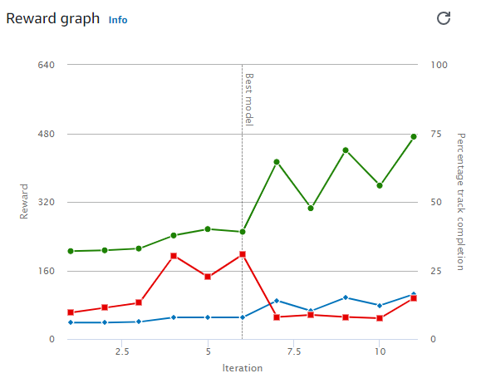
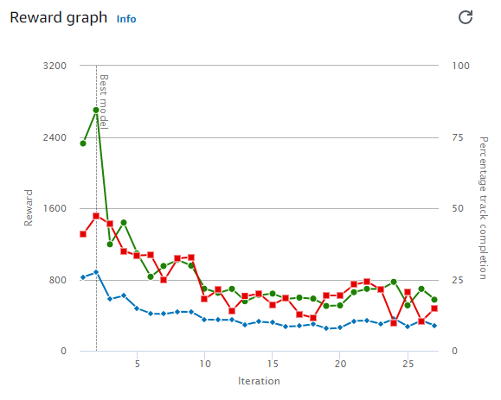
Negative Training

Slide 17
Evaluating Models
4 models passed evaluation within the short time trained
times are in (MM:SS:mmm)
Model details | Lap 1 | Lap 2 | Lap 3
Time trial v_1 | 00:26.533 | 00:26.034 | 00:26.347
Time trial v_5 | 00:17.592 | 00:17.462 | 00:18.210
Object avoidance v_5 | 00:25.400 | 00:24.000 | 00:24.668
Object avoidance v_t5.4 | 00:18.262 | 00:17.486 | 00:18.283

Slide 18
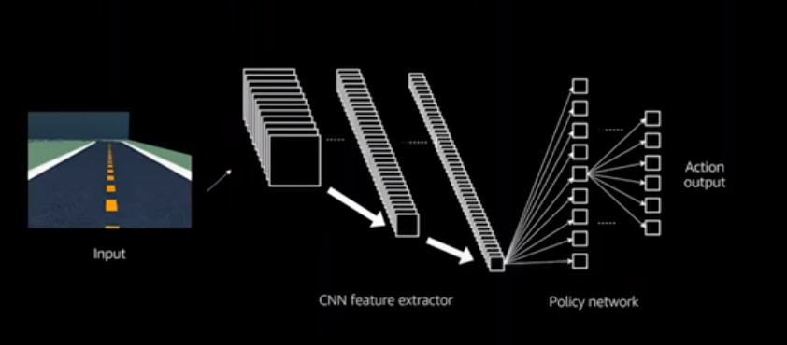
Convolutional Neural Network
Must now rely solely on sensors for image processing.

Slide 19
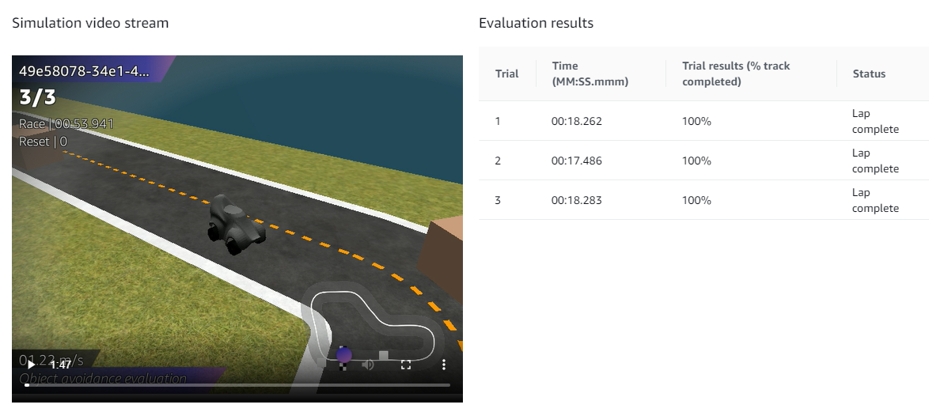
Best Performing Model

Slide 20
Conclusion
4 models passed evaluation
2 in time trials
2 in object avoidance with 2 fixed objects
Important Setup
Discount factor for hyperparameters
Stereo camera for sensors
Waypoints and objects_location for parameters
Only 29% of project’s budget was used
Training times need to be increased for more robust results

Slide 21
Next Steps
Setup environments with lower training costs
Local setup
Using individual AWS services and spot pricing
Create optimal waypoints for left and right lanes
Evaluate more scenarios after longer training times
Compete in head-to-head races

Slide 22
Questions?
References:
AWS (2021). AWS DeepRacer Developer Guide.
AWS (2021). Input Parameters of the AWS DeepRacer Reward Function.
Kesha Williams (2020). Get rolling with machine learning on AWS DeepRacer.

